Slide 1
Chinese Classifications in Alma Analytics
Yoel Kortick
Senior Librarian

Slide 2
Introduction
Where does the Chinese Classification field come from?
Where does the Chinese Classifications folder come from?
Sample reports

Slide 3
Introduction

Slide 4
Introduction
In this presentation we will show how it is possible to use the Chinese Classifications to report on various activities via Alma Analytics.
The Chinese Classifications are represented in Alma Analytics in
The “Chinese Classification” field in the shared “Bibliographic Details” folder
The “Chinese Classifications” folder in the shared “Other Classifications” folder

Slide 5
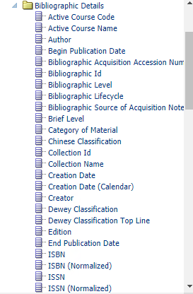
Introduction
The “Chinese Classification” field in the shared “Bibliographic Details” folder

Slide 6
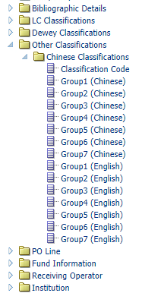
Introduction
The “Chinese Classifications” folder in the shared “Other Classifications” folder

Slide 7
Introduction
Like the other “Classifications” in Alma Analytics, such as LC Classifications and Dewey Classifications, the Chinese Classifications can be used to gain an in depth understanding of the institutional repository.
For example:
  Which subjects are most used (have the most loans)?
  From which vendors have which subjects been purchased?
  How do the repository content subjects compare to the institutional faculty areas? (are there faculties under-represented in the collection?)

Slide 8
Where does the Chinese Classification field come from?

Slide 9

Where does the Chinese Classification field come from?
We are referring here to the “Chinese Classification” field in the shared “Bibliographic Details” folder
If record is CNMARC the Chinese Classification comes from 690.a
If record is MARC 21 the Chinese Classification comes form 090.a and 093.a
If record is UNIMARC or KORMARC then there is no Chinese Classification

Slide 10
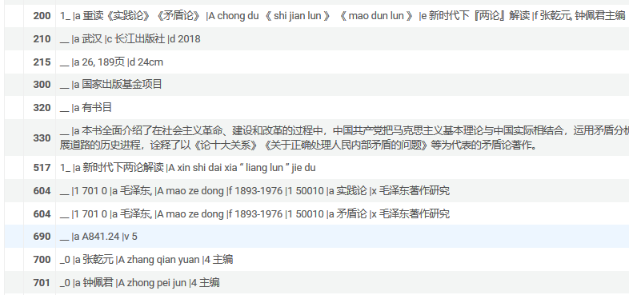
Where does the Chinese Classification field come from?
Alma Analytics
CNMARC Record in Alma

Slide 11
Where does the Chinese Classifications folder come from?

Slide 12
Where does the Chinese Classifications folder come from?
The subjects listed in the Chinese Classifications folder come from the official Chinese Library Classification (CLC) site at http://222.128.60.220:8992/F/-?func=cat-list&CON_LNG=xng

Slide 13
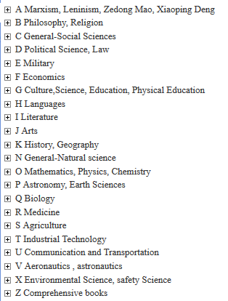
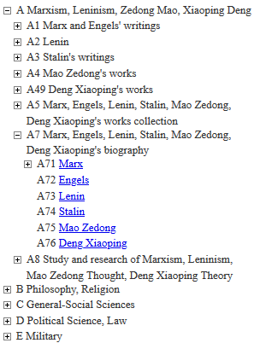
Where does the Chinese Classifications folder come from?

Slide 14
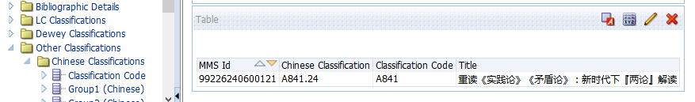
Where does the Chinese Classifications folder come from?
The “Classification Code” field in the “Chinese Classifications” folder is based on the “Chinese Classification” field in the “Bibliographic Details” folder.
In some cases it is identical, and in some cases it is truncated.
Below it is truncated from A841.24 to A841

Slide 15
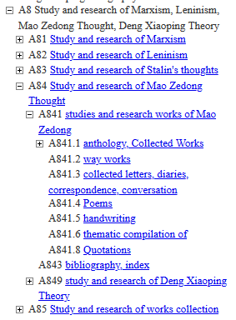
Where does the Chinese Classifications folder come from?
The reason it is truncated is because the official Chinese Library Classification (CLC) site does not have “A841.24”, but does have “A841”.
When the value after the decimal point does not exist then it is dropped.

Slide 16
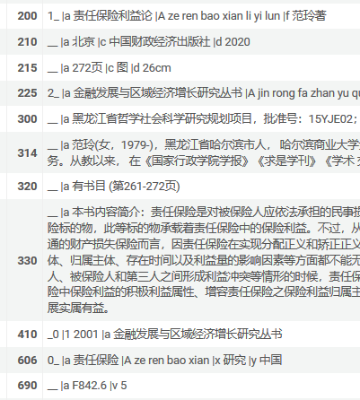
Where does the Chinese Classifications folder come from?
For MMSID 99226012900121 the Chinese Classification is F842.6

Slide 17

Where does the Chinese Classifications folder come from?
The classification code F842.6 is not truncated

Slide 18
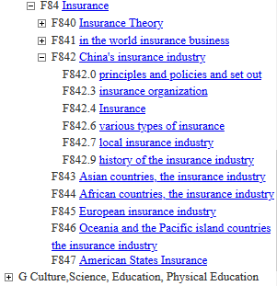
Where does the Chinese Classifications folder come from?
The reason it is not truncated is because F842.6 exists in the official Chinese Library Classification (CLC) site

Slide 19
Where does the Chinese Classifications folder come from?
The values for the “groups” of the Chinese Classifications come from the corresponding values of the classification the official Chinese Library Classification (CLC) site.
For example here is a record with classification code “A841”.

Slide 20
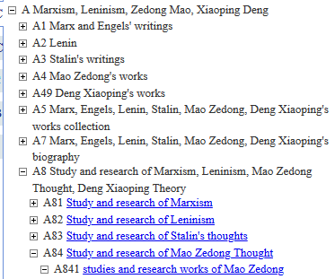
Where does the Chinese Classifications folder come from?

Slide 21
Where does the Chinese Classifications folder come from?
The values for the “groups” of the Chinese Classifications come from the corresponding values of the classification the official Chinese Library Classification (CLC) site.
For example here is a record with classification code “F842.6”.

Slide 22
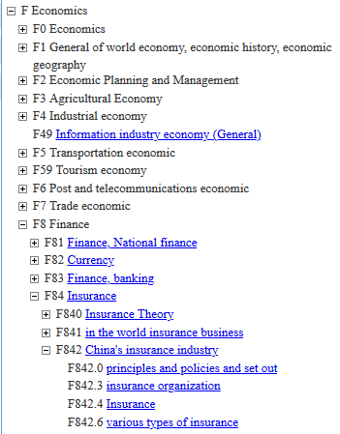
Where does the Chinese Classifications folder come from?

Slide 23
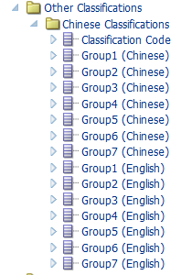
Where does the Chinese Classifications folder come from?
Here are both examples with the Chinese Classification in Chinese

Slide 24
Sample reports

Slide 25
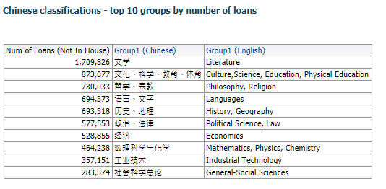
Sample reports – number of loans
Here we can see the top ten Chinese Classifications for number of loans. In this way we know what topics are being most used in the repository.

Slide 26
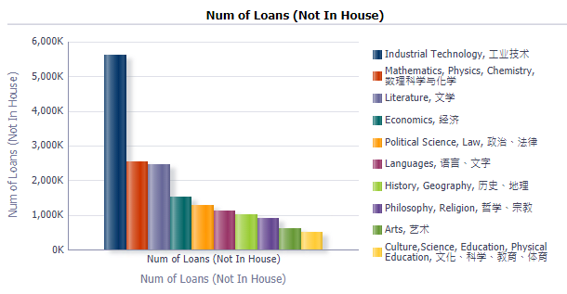
Sample reports – number of loans
Here is the same data in a bar graph

Slide 27
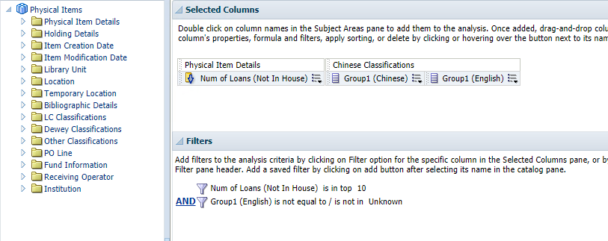
Sample reports – number of loans
Here is how the report was made.

Slide 28
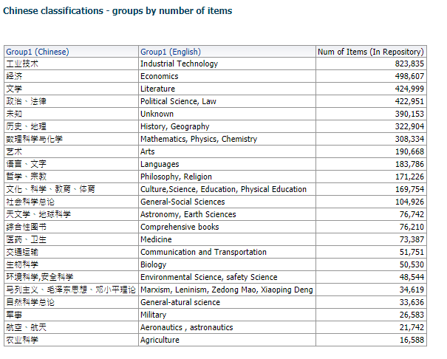
Sample reports – number of items
Here we can see the number of items according to the Chinese Classifications. In this way we know we quickly get an overall picture of the makeup of the repository.

Slide 29
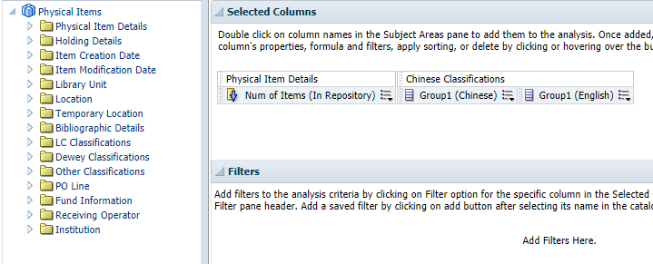
Sample reports – number of items
Here is how the report was made

Slide 30
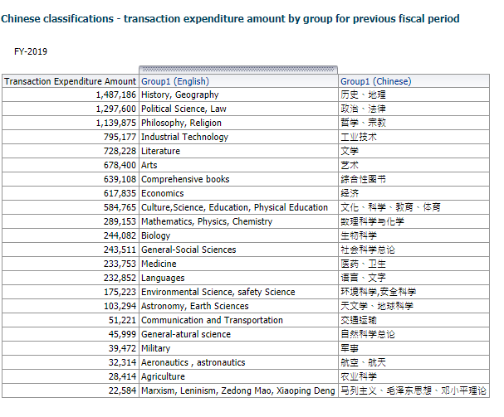
Sample reports – Transaction expenditure amount
Here we can see the number of items according to the Chinese Classifications. In this way we know we quickly get an overall picture of how funds are being used.

Slide 31
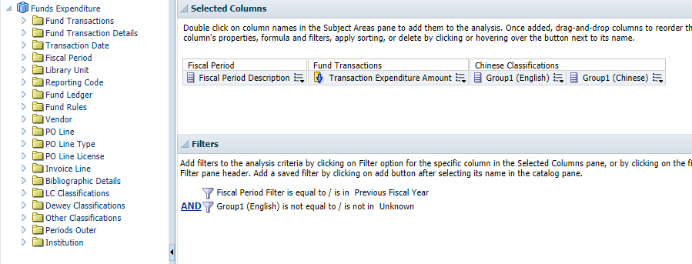
Sample reports – Transaction expenditure amount
Here is how the report was made

Slide 32
Yoel.Kortick@exlibrisgroup.com

